Slide 1
UIT2301 – Programming and Design Patterns
Strings and Regular Expressions

Slide 2
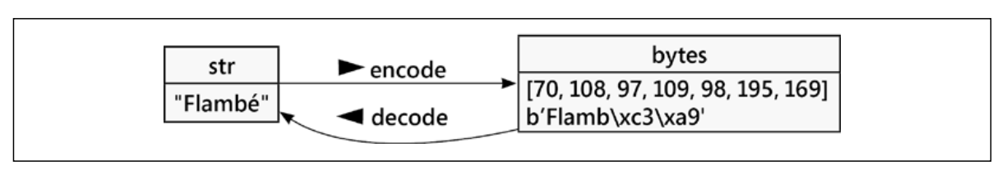
Introduction
Python strings can represent a sequence of any character
Python strings are all represented in Unicode, a character definition standard that can represent virtually any character in any language on the planet.
Python 3 strings is an immutable sequence of Unicode characters

Slide 3
Strings and Bytes
Python will show a bytes value as b'Flamb\xc3\xa9’.
In a bytes value, the letters are shorthand for numbers and use the older ASCII encoding scheme.

Slide 4
String Manipulation
String is a sequence of characters wrapped in ‘ ‘ or “ “ or “”” “”” or ‘’’ ‘’’
Like other sequences, strings can be iterated over (character by character), indexed, sliced, or concatenated. The syntax is the same as for lists and tuples.

Slide 5
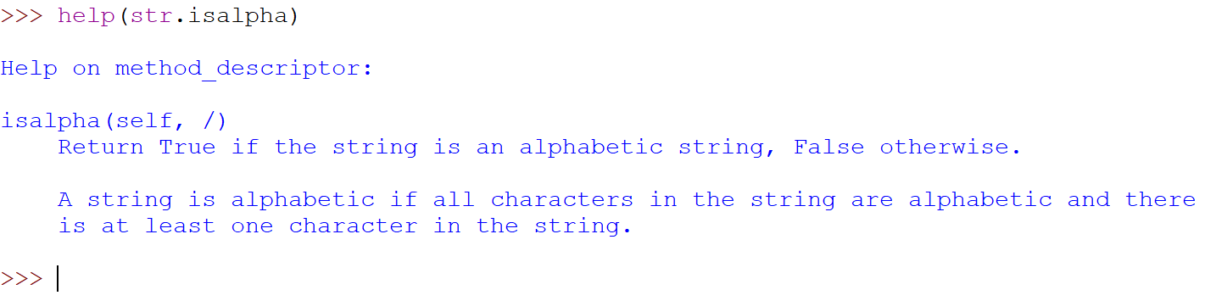
String Manipulation - str class
dir() and help()
Pattern matching string functions (Returns Boolean):
isalpha()
isupper()
islower()
startswith()
endswith()

Slide 6
String Manipulation - str class
Pattern matching string functions (Returns Boolean):
istitle(), isdigit(), isdecimal(), isnumeric()
Pattern matching string functions (Returns Non-Boolean):
count(), find(), index(), rfind(), and rindex()
String methods operating on lists:
split(), rsplit(), partition(), rpartition(), join(), replace()

Slide 7
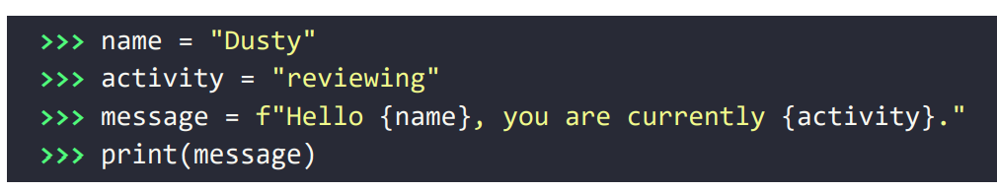
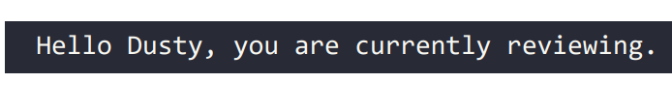
String formatting – f-string

Slide 8
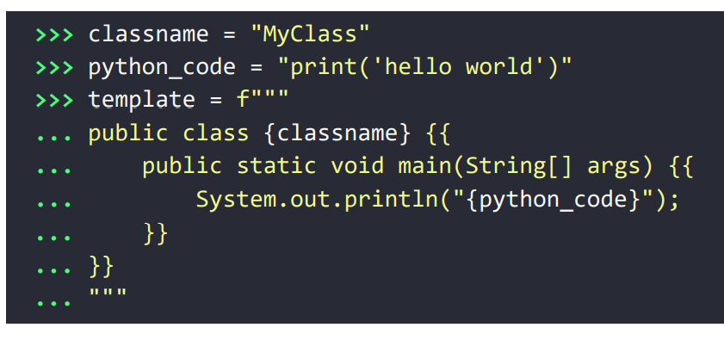
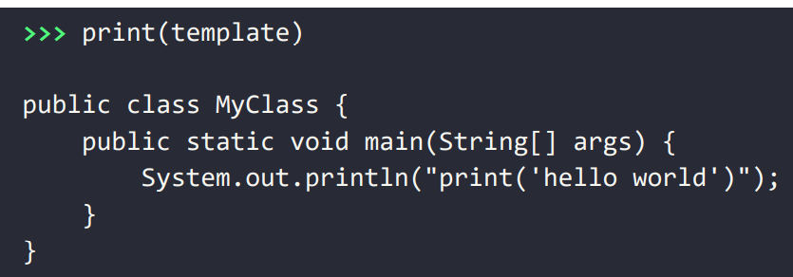
Braces in f-string

Slide 9
format()
format() is a more general method to plug values into a string template
3 types:
By name
By position
By implied position

Slide 10
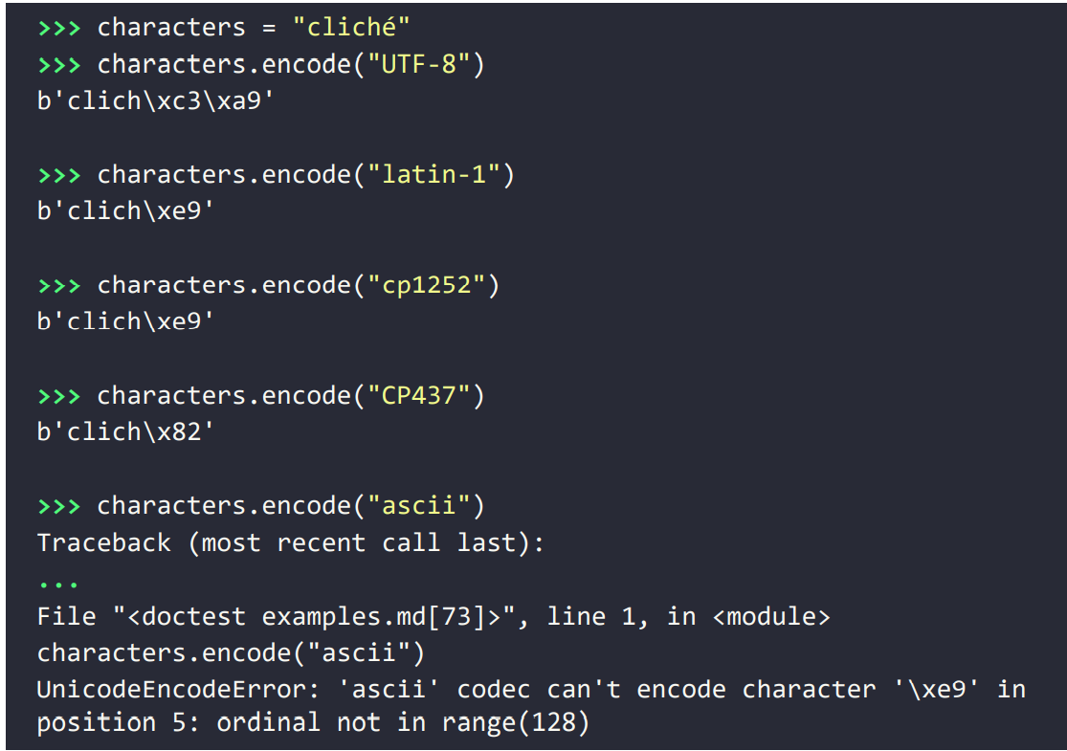
Encoding Text to Bytes
Encode()
Decode()

Slide 11
Handling Encoding Error in ASCII
The encode method takes an optional string argument named errors that can define how such characters should be handled.
This string can be one of the following:
"strict“ – Default error
"replace“ - the character is replaced with a different character (ASCII – it is a ?)
"ignore“ - Discards any byte it doesn't understand
"xmlcharrefreplace“ - creates an xml entity representing the Unicode character
Exception is raised

Slide 12
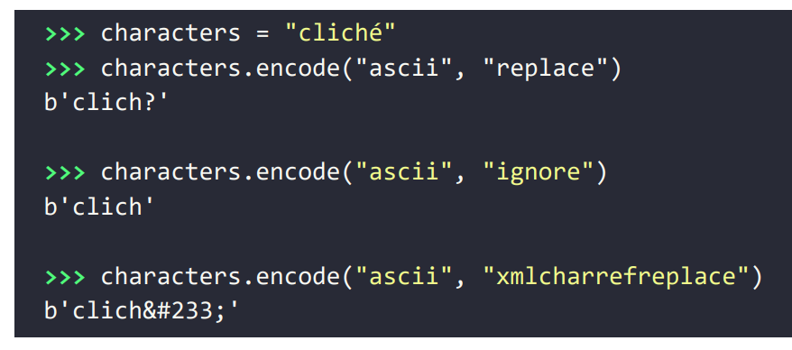
Handling Encoding Error in ASCII

Slide 13
Changing from immutable to mutable
byte type is immutable like str
Allows operations like slice but not replace
Alternate: bytearray
Allows: append(), replace()

Slide 14
Regular Expression (RE)
A RegEx, or Regular Expression, is a sequence of characters that forms a search pattern.
RegEx can be used to check if a string contains the specified search pattern.
In-built module – re
“import re”

Slide 15
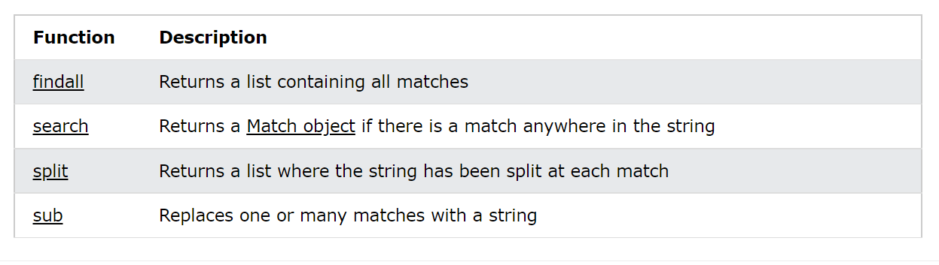
RegEx Functions

Slide 16
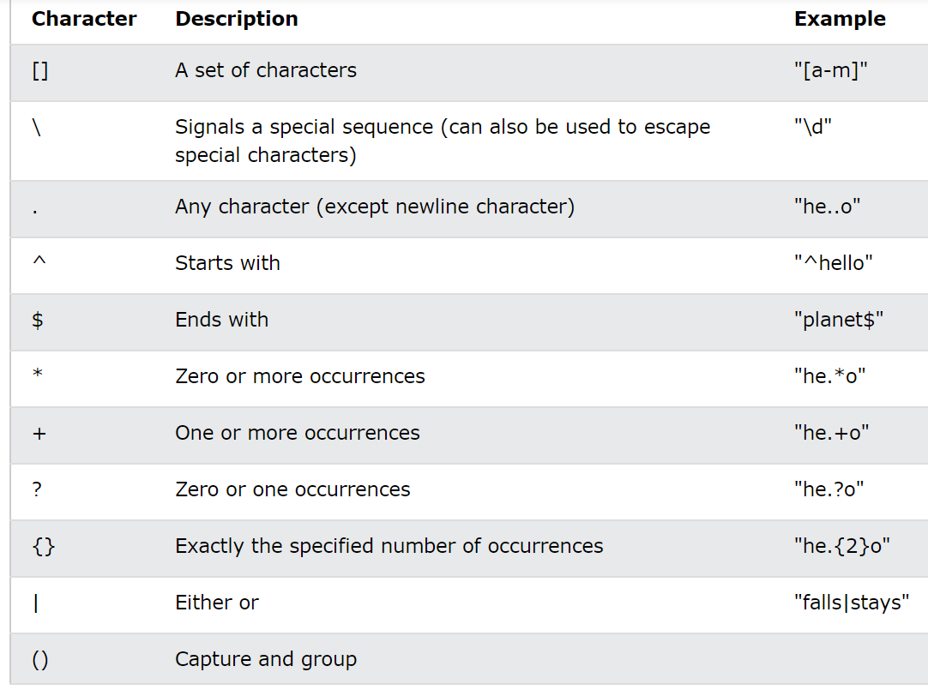
Metacharacters

Slide 17
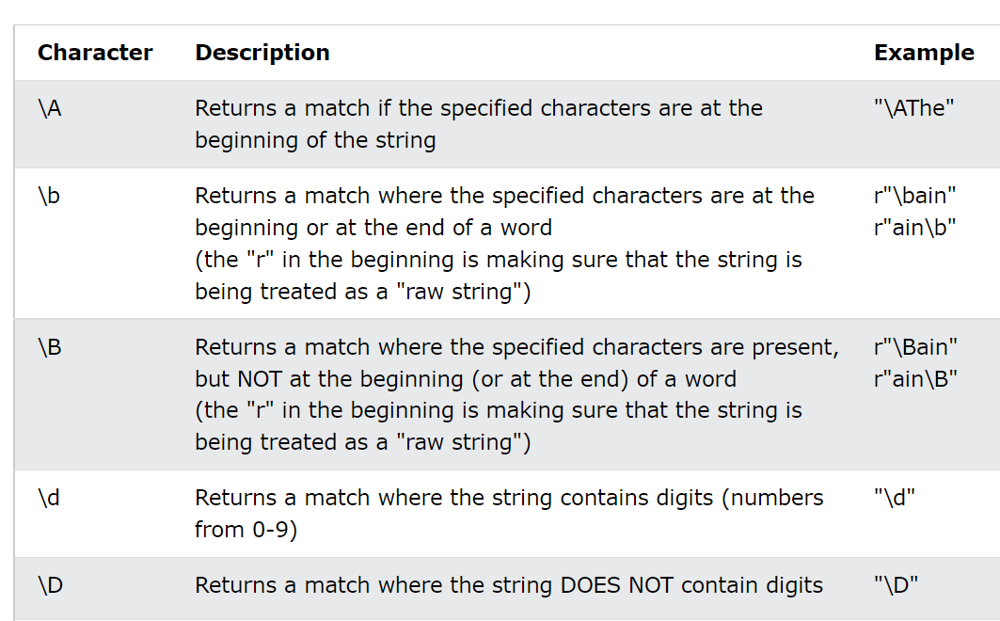
Special Sequences

Slide 18
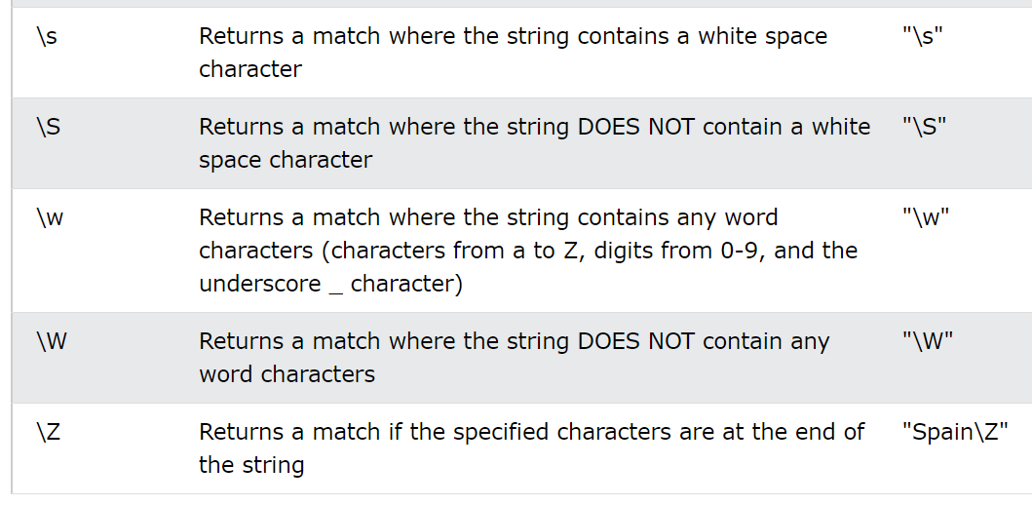
Special Sequences

Slide 19
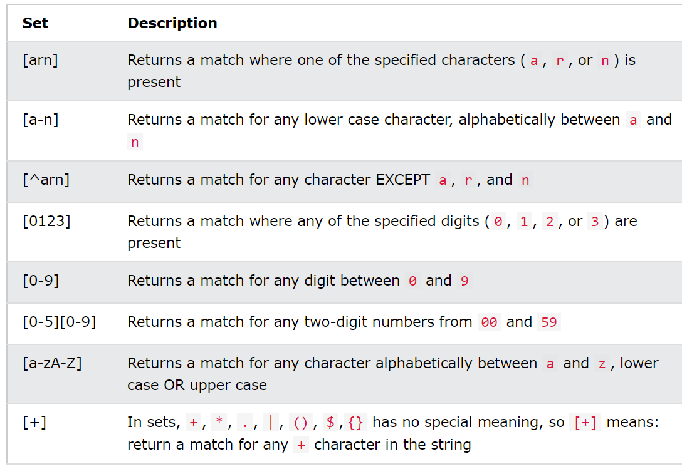
Sets

Slide 20
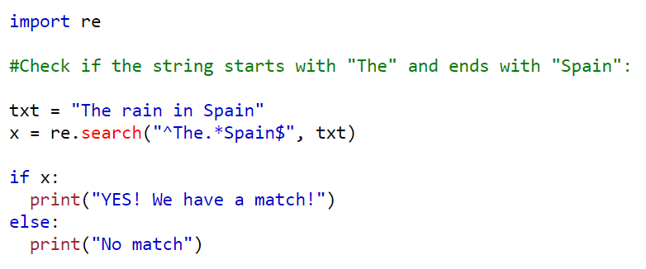
Try to understand
OUTPUT: YES! We have a match!

Slide 21
Books
TEXTBOOKS:
Dusty Phillips, “Python 3 Object-Oriented Programming: Build robust and maintainable software with object-oriented design patterns in Python 3.8”, Third Edition, Packt Publishing, 2018.
REFERENCES:
Matt Weisfeld, “Object-Oriented Thought Process”, Fifth Edition, Addison-Wesley Professional, 2019.
Matthias Noback, “Object Design Style Guide”, Manning Publications, 2020.
Stephen F. Lott, “Mastering Object-oriented Python”, Second Edition, Packt Publishing, 2019.
Mark Lutz, “Programming Python: Powerful Object-Oriented Programming”, Fourth Edition, O’Reilly Media, 2011.

